Slide 1
Qualcomm Innovate in Taiwan
Challenge 2021
5G Communication Module of AI
base on Quantum Microcomputer
in Wireless Vehicular Network
A Good Intention AI Co., Ltd.
Quantum Computer of RD Department
AGAI Bullrun701 Team
http://www.free-powerpoint-templates-design.com

Slide 2
Q
How to improve our live with 5G Communication of Network?

Slide 3
Ans
IOT
AI
Wireless Vehicular Network

Slide 4
Vehicular
AI
5G
Topics
Prevent collision
Locate pedestrian
Speed up the localization
Improve efficiency of the facility

Slide 5
What Vehicles can prevent collision and locate pedestrian, even the accident can be reduced and lives can be safer?
Q

Slide 6
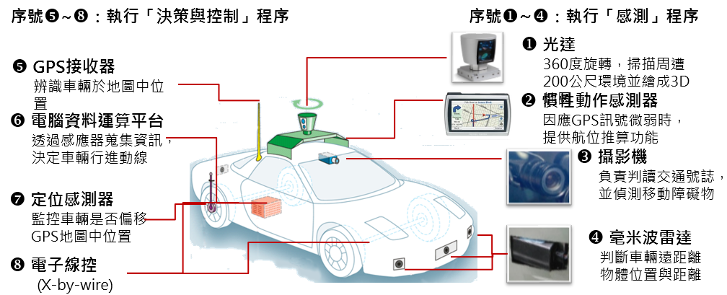
Assume each vehicle is able to send signal to each other and estimation the signal strength. With the signal strength, vehicle can estimate the distance of the the sensor. Therefore, it can estimate its position by formulating the problem to quadratic functions and solved using quantum optimization.
01
02
03
Sensor + GPS
AI + Computer Vision
Edge Computing
Prevent Collision
Locate Pedestrian
Accident Reduced
https://www.automan.tw/news/newsContent.aspx?id=2725
What can be solved or support by Quantum Computing?

Slide 7
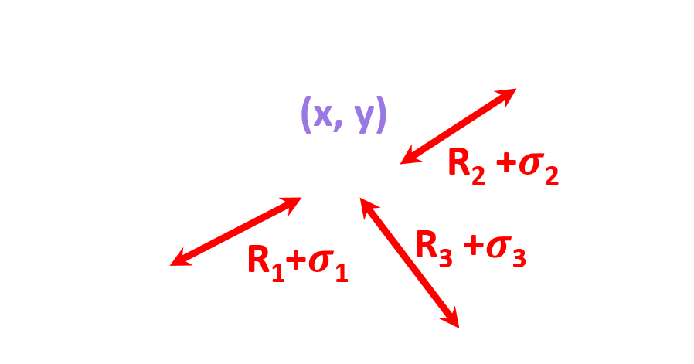
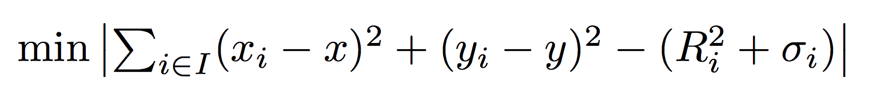
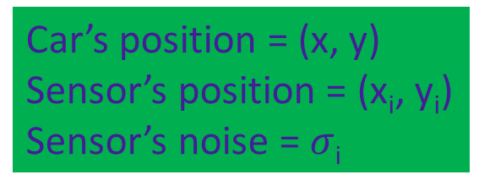
Quantum Algorithm
can support computing Vehicle Localization
Problem Type
Optimization problem
Method
Quantum approximate Optimization Algorithm
Quantum Advantage
Solve NP problem in Classical Computer
Speedup your Computing Time
Car’s position = (x, y)
Sensor’s position = (x_{i}, y_{i})
Sensor’s noise = $σ$_{i}
Guerreschi, G.G., Matsuura, A.Y. QAOA for Max-Cut requires hundreds of qubits for quantum speed-up.
Sci Rep 9, 6903 (2019). https://doi.org/10.1038/s41598-019-43176-9

Slide 8
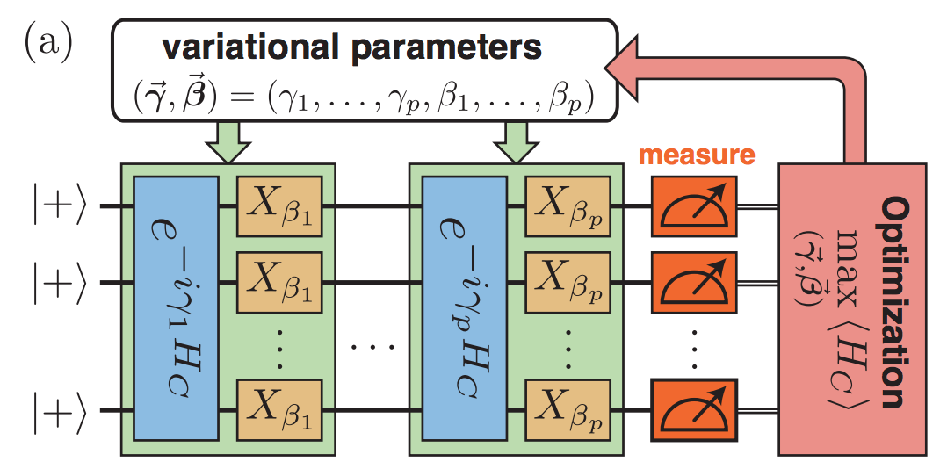
Quadratic Problem
QAOA
hybrid quantum-classical variational algorithm
designed to tackle combinatorial optimization problems
NP-hard problem
Can be mapping into QAOA (Quantum Approximate Optimization Algorithm)
arXiv:1812.01041v2

Slide 9
How does we Integration 5G Communication of Wireless Vehicular Network & Quantum Computing to IOT Application scenarios?
How does we create this 5G Communication of Network Product?
P

Slide 10
How to Integration 5G Communication and Quantum Computing?
We only need to using Evaluation Board and 5G Chip and antenna, building an Communication Module.
We should install quantum computer SDK on Microcomputer Chip.
Combine this Communication Module and Microcomputer Chip to a Sensor Device

Slide 11
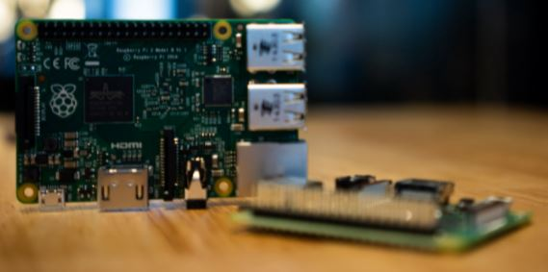
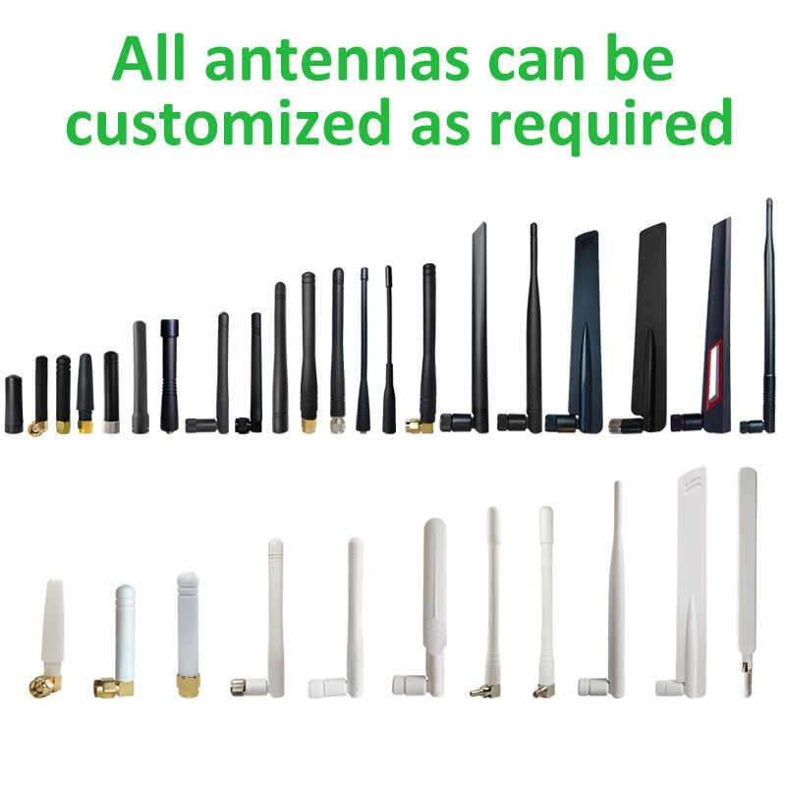
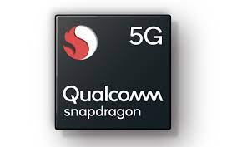
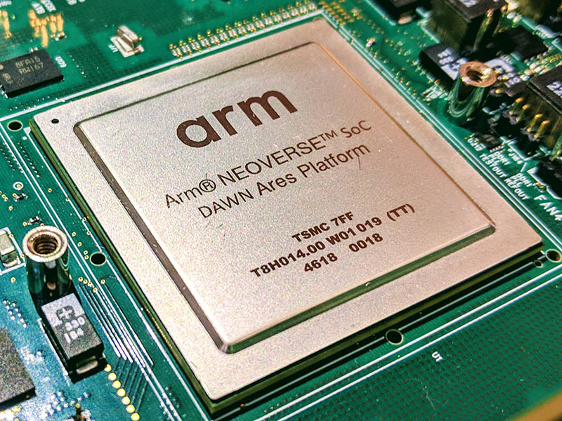

Our Idea Production 5G Quantum Microcomputer Sensor
5G Chip
Evaluation Board
5G Antennas
Quantum SDK
Picture source by google Image Search

Slide 12
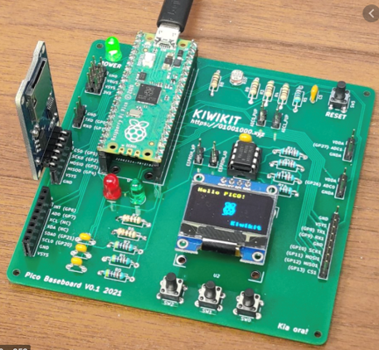
Final Creation 5G Quantum Microcomputer Sensor

Slide 13
How does we create this 5G Communication of Network Product?
Finding a sample of 5G Communication Module
Fallowing this sample to Copy-DIY our Microcomputer
Install Qiskit and our Quantum Code on Microcomputer

Slide 14
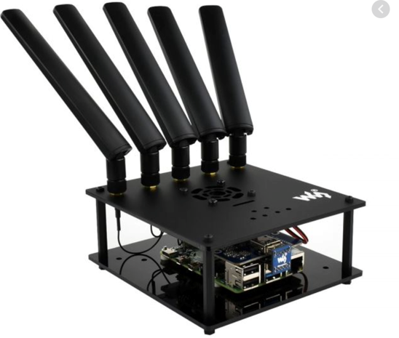
Finding a sample 5G Communication Module
AGAI Sensor Device

Slide 15
Copy-DIY our Microcomputer
5G Chip(communication+AI)
Embedded
5G Antennas
Evaluation Board
Embedded
15
Picture source by google Image Search

Slide 16
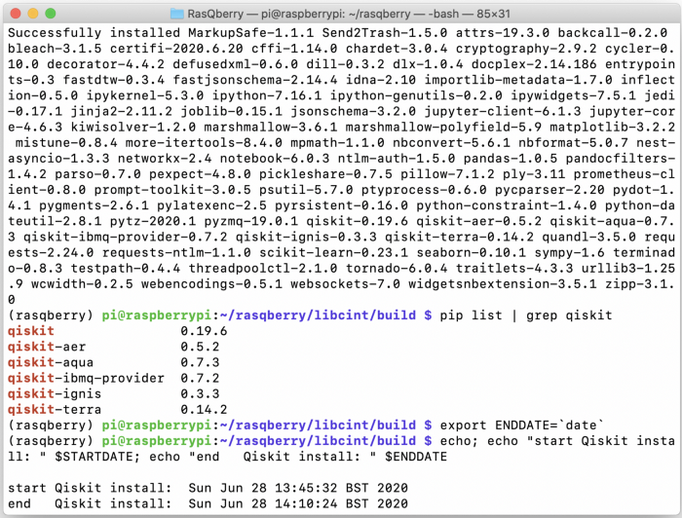
Install Qiskit on Microcomputer
https://medium.com/qiskit/rasqberry-quantum-computing-is-the-coolest-project-for-raspberry-pi-3f64bec5a133
Evaluation Board

Slide 17
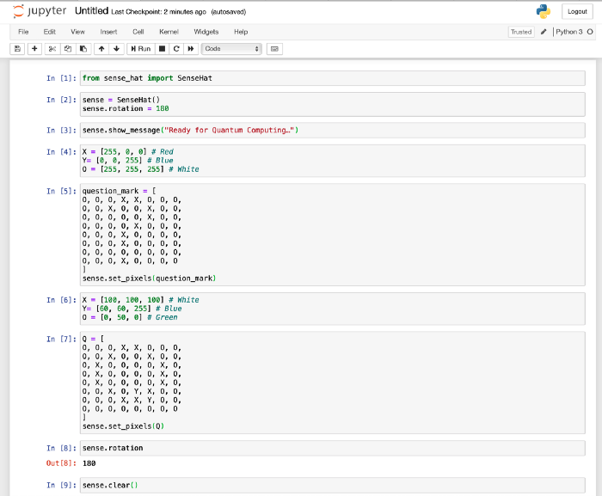
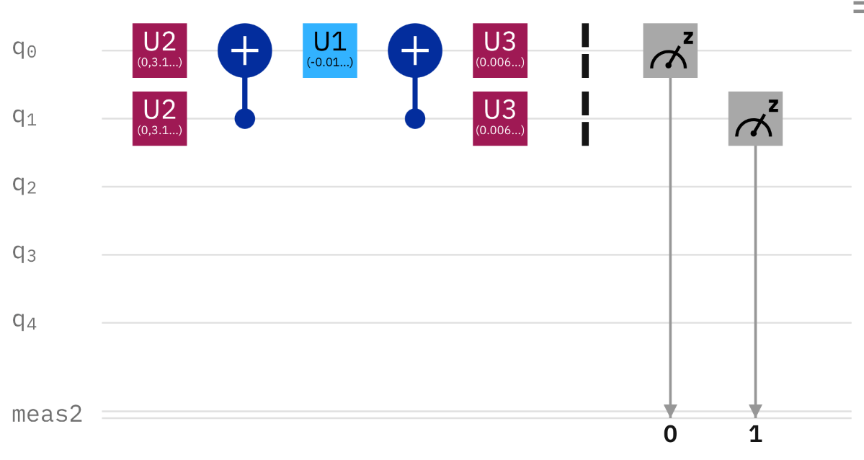
Install our Quantum Code on Microcomputer
Quantum Approximate Optimization Algorithm
burn code
Evaluation Board
Quantum Programming

Slide 18
Final DEMO 5G Quantum Microcomputer Sensor

Slide 19
Future work 5G Quantum Microcomputer Sensor deploy
https://www.automan.tw/news/newsContent.aspx?id=2725
01
Sensor + GPS
02
AI + Computer Vision
03
Edge Computing

Slide 20
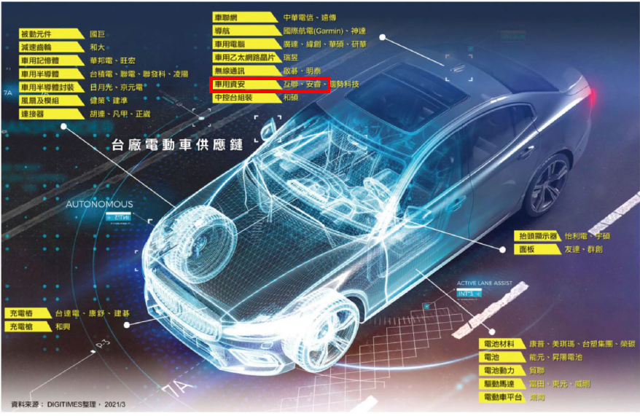
Future work Wireless Vehicular Network Security on 5G

Slide 21
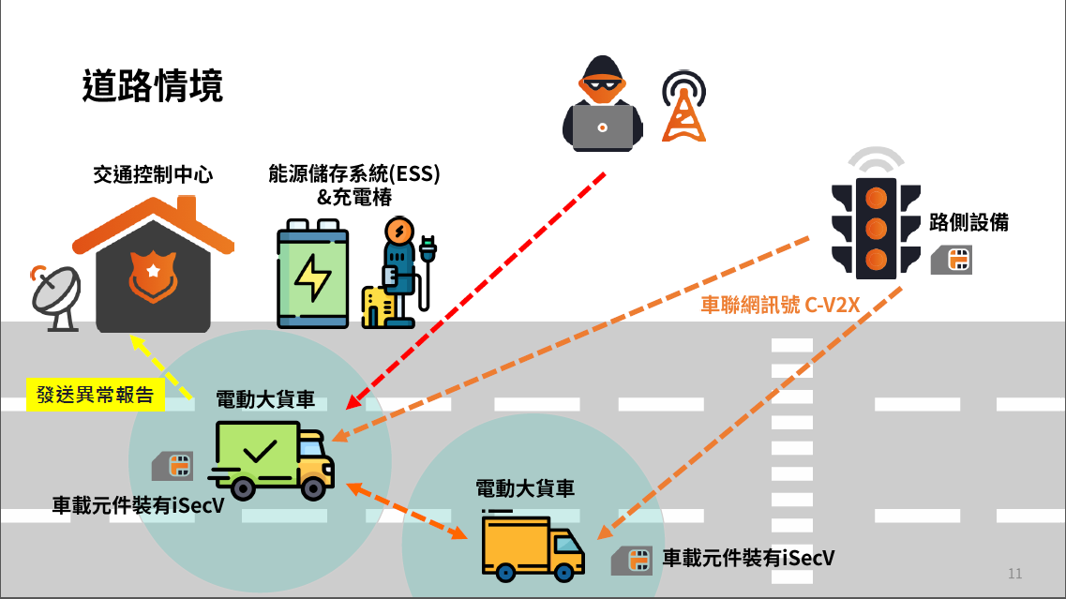
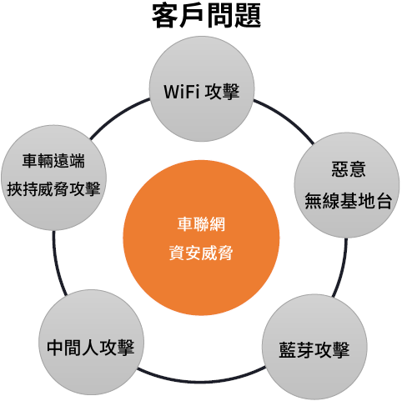
Wireless Vehicular Network Security Scenarios on 5G

Slide 22
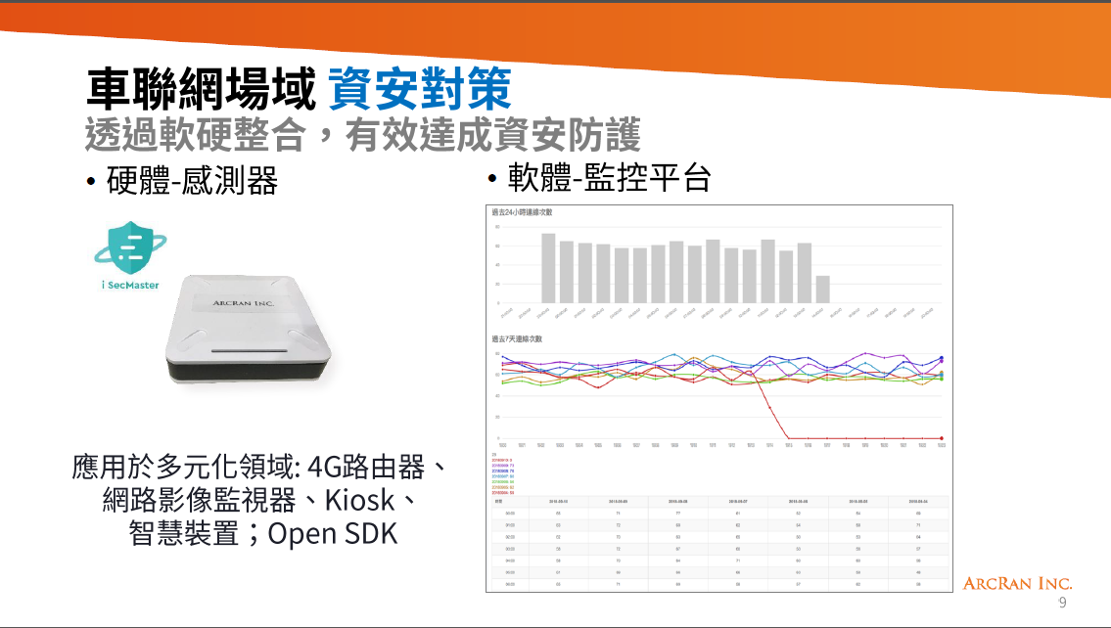
Our Cooperative manufacturer can used 5G Quantum Microcomputer Sensor deploy on Their 5G Security Solution Consultant

Slide 23
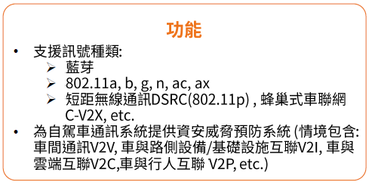
5G Quantum Microcomputer Sensor has Expansion Module

Slide 24
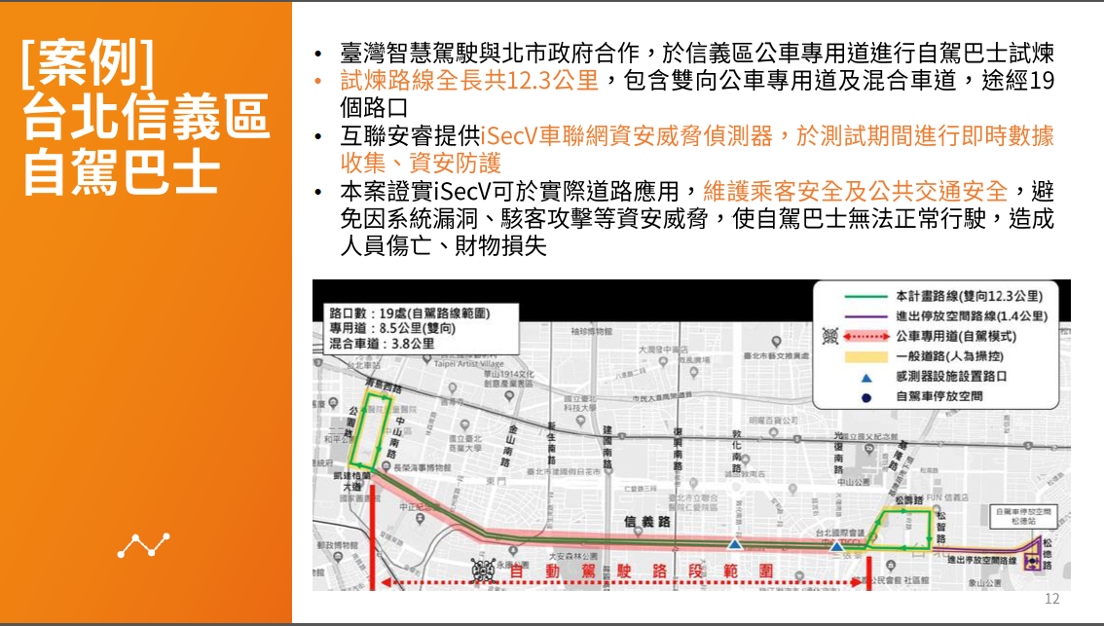
We can Application on 5G Wireless Vehicular Network Security Market with Our Cooperative manufacturer

Slide 25
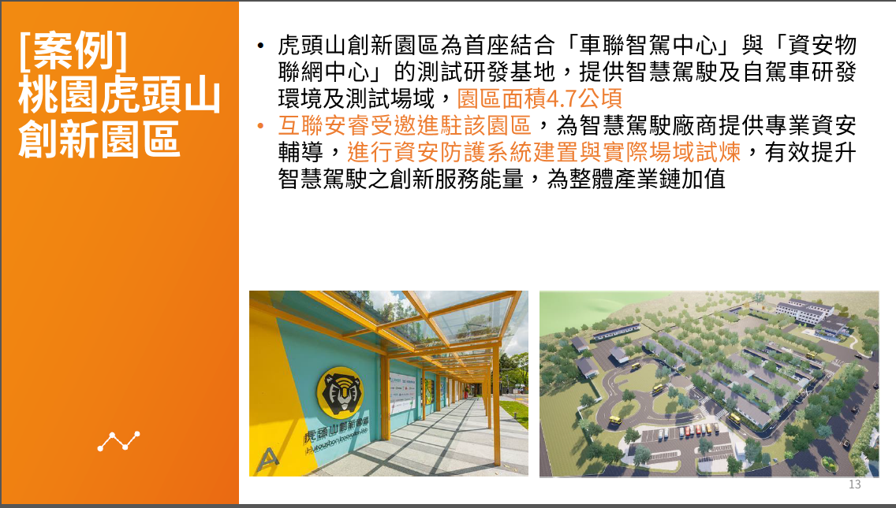
We can Application on 5G Wireless Vehicular Network Security Market with Our Cooperative manufacturer

Slide 26



Conclusions
We Integration 5G Communication of Wireless Vehicular Network and Quantum Computing to IOT Application scenarios.
Final We create a 5G Communication of Network Product by Copy-DIY
IN the future, we deploy to Wireless Vehicular Network Security on 5G with our Cooperative manufacturer.

Slide 27
Thank you for your attention!
We are AGAI Bullrun701 Team

